Slide 1


THE IDIOTS VILLAGE

Slide 2






MEET THE TEAM
Kyanne
Crew
Daniel
Connor
Matt
Tommy Smith

Slide 3



What is “The Idiot’s Village”?
A Social Media Platform for the Rest of Us
Key Features
Authentication
Profiles
Posts
Messaging
Points system
Gambling
Dating
Villages
Raids
TIV is a stress-free, intuitive social media platform designed for users who feel overwhelmed or out of place on mainstream platforms. Our goal is to foster connection, entertainment, and engagement in an inclusive and simplified online environment.
Connor

Slide 4

In-Scope for V1.0
Authentication
Buying points
Messaging
Groups (Villages)
Direct Messaging
Gambling
Blackjack
Roulette
Poker
Plinko
Higher or Lower
Minesweeper
Auto-banning
No Dept
Profile Page
IQ Tag
Pronoun Tags
Verified badges
Birth Date
Username Color
Gaining points
Purchasing
Log-in streak
Gambling
Posts
Public
Friend-only
Notes:
Daniel and Crew

Slide 5

Out-of-Scope for V1.0
In-depth Dating
Cashing out your points
Raids on Villages
Age verification
Notes:
Daniel and Crew

Slide 6
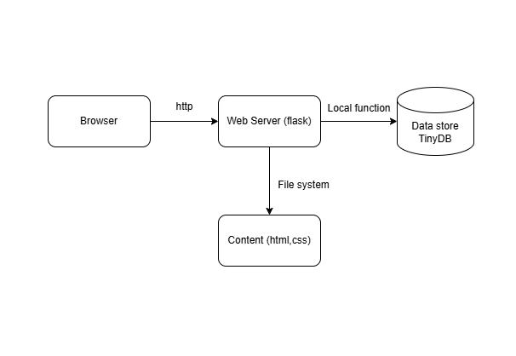
Solution Architecture
Dependencies
User interface
Tailwind
HTML5
JS
Server
Flask
Socket.io
Database
Tiny DB
Payments
Stripe
Security
BCrypt
CREW
Notes:
Daniel

Slide 7

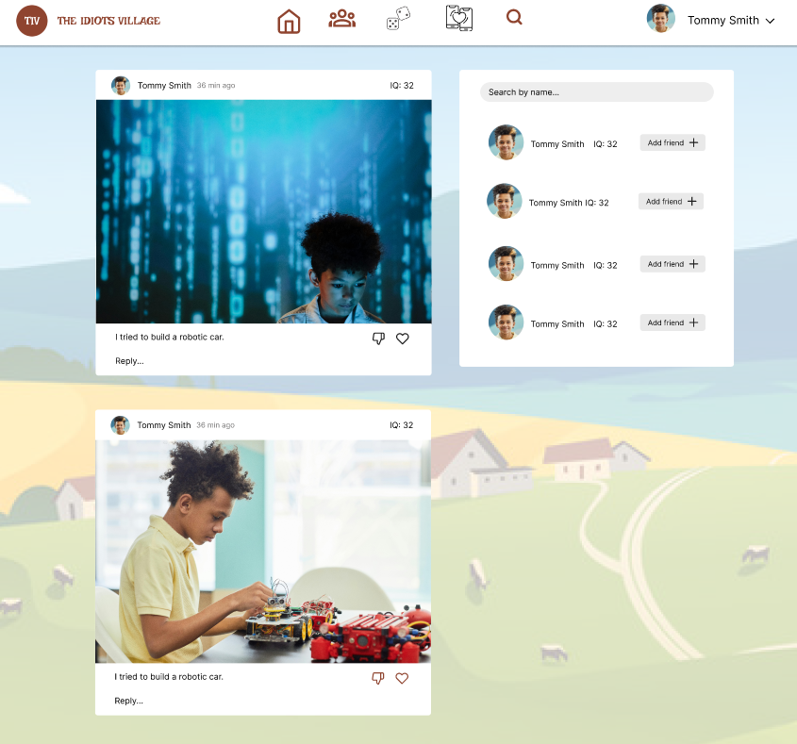
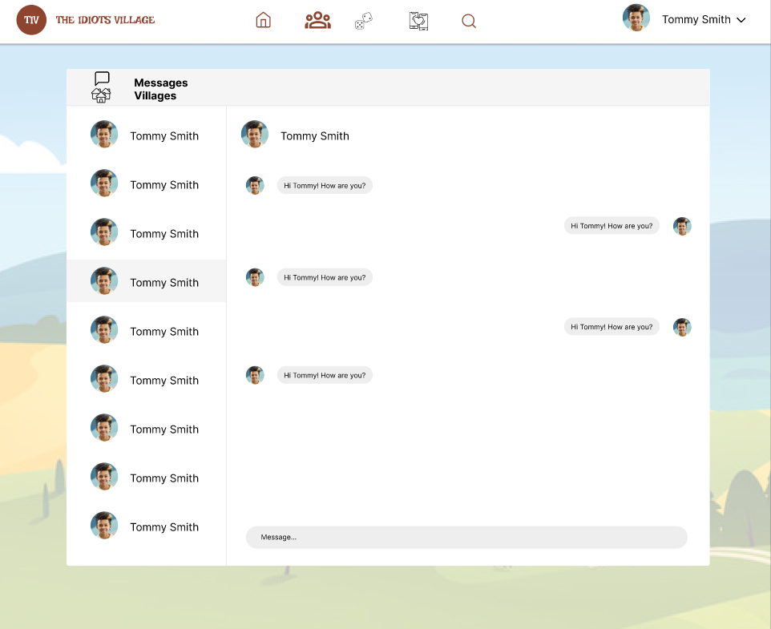
_UI Mockup_
Kyanne
Home
Messages
Notes:
Kyanne

Slide 8
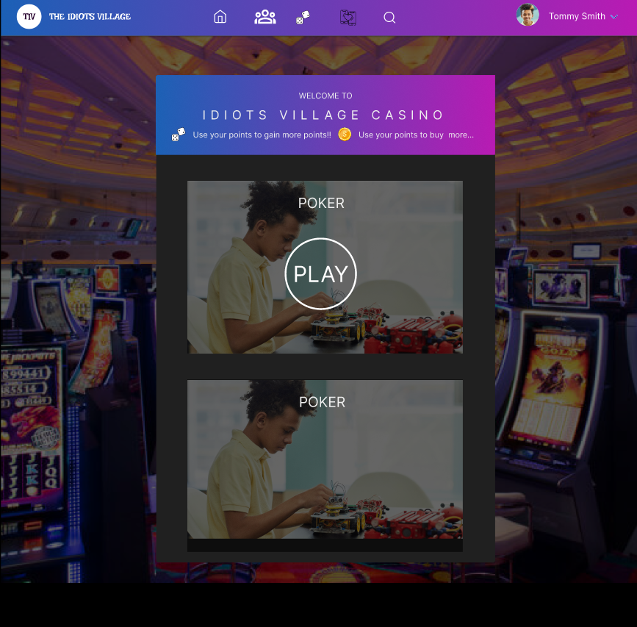
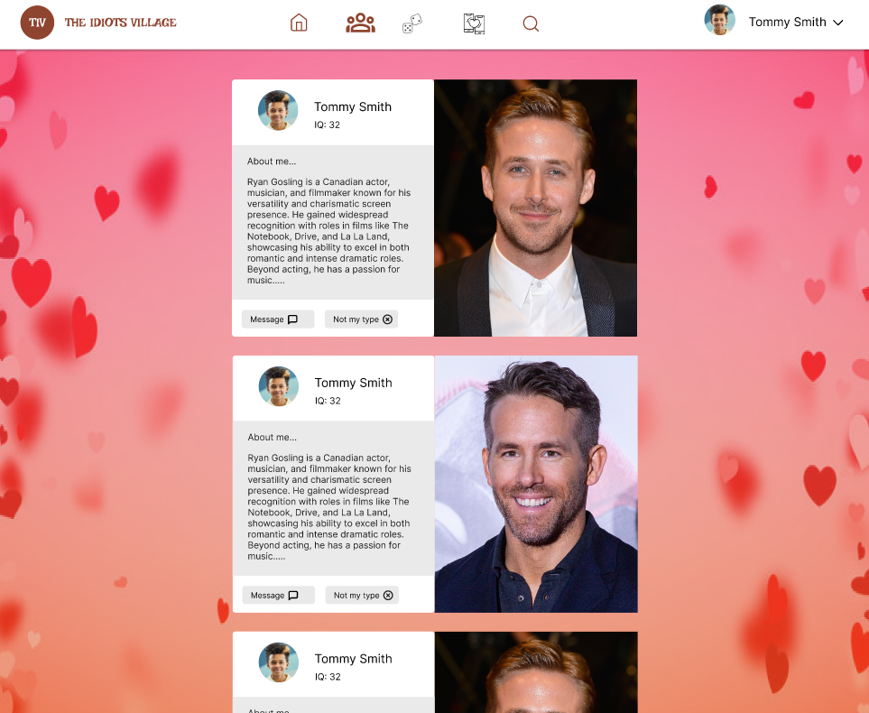
Gambling
Daniel
Dating
https://www.figma.com/design/vGnqIJvK9wpGlk8BcUoalJ/Village-Idiots?node-id=0-1&p=f&t=X7PaE2yjSgh56cM1-0
Notes:
Daniel and Crew

Slide 9

Summary and Conclusion
In Scope
Out of Scope
Authentication
Points
Messaging
Posts
Gambling
Profiles
TIV provides an inclusive, easy-to-use social space where users can connect, play, and engage without the pressure of social comparison.
By integrating social networking, entertainment, and gaming, we are creating a fun, intuitive, and engaging alternative to traditional platforms.
Dating
Cashing out your points
Raids
Kyanne

Slide 10
Q&A

